Slide 1
Public-Private Partnerships in Rwanda: establishment of health posts and Lessons learnt
Chantal INGABIRE
29 March 2019
EAHRC Conference/ Tanzania

Slide 2
Rwanda referral health system
National
Province
District
Sector
Cell
Village

Slide 3
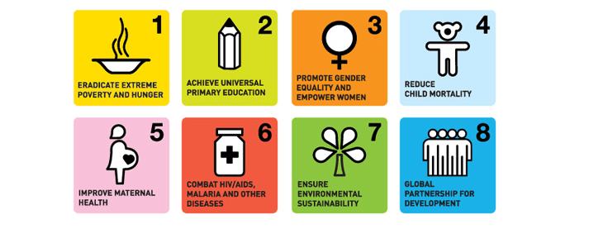
The Rwandan Context: A decade of advancements
Rwanda’s DHS has recorded great progress, meeting all of MDGs targets.

Slide 4
Infant and under five mortality

Slide 5
Immunization coverage
Over 93% of children (12-23 months) are protected from illness
Notes:
WHO Recommended Vaccination Coverage

Slide 6
Births at health facilities

Slide 7
A journey towards the sustainable development goals (SDGs)
Achievement of the SDGs will require innovative strategies and PPP is the way to go

Slide 8
The law governing Public-Private Partnerships (PPP) in rwanda
Law No. 14/2016 governing PPP in Rwanda.
Solicited : An expressed need of the contracting Authority (i.e. government) to potential partners.
Unsolicited: A PPP project not in response to an expressed request for proposals.
Various PPP types as per the Law:
A contracting Authority awards a partner the right to manage and perform specific services.
“Build-Operate-Own”: A partner designs, constructs, owns and operates an infrastructure facility/asset to provide services.
Build-Operate-Transfer”: A partner finances, designs, constructs an infrastructure facility to provide services for an agreed time period after which a transfer is made to the government.
Lease-Operate-Develop”: A contracting Authority grants a Partner a lease to operate and develop an existing infrastructure facility or other asset for an agreed time.

Slide 9
Decentralizing of health services as key
In 2018, Rwanda created the Health Post, a new, nurse-led facility for further decentralization of services to the cell level.
Between 5000-7000 people targeted
To reach citizens that still work over 60 minutes from Health Centers

Slide 10
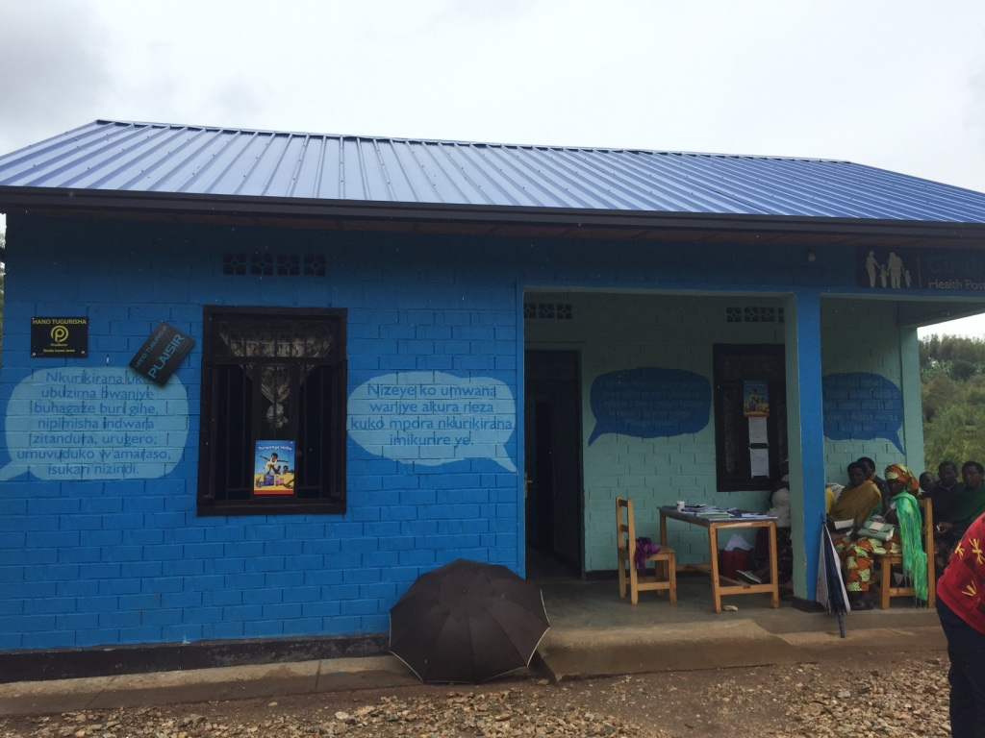
Health Posts- furthest decentralized health facilities
Fit directly into national geographic web of facilities.
Use the referral system methodology already in place.
Linkage with procurement, clinical supervision, and monitoring and evaluation data- to already-present sector and district health facilities.

Slide 11
a Public Health Post and a Public-Private Partnership (PPP) Health Post
Public Posts supervised and directly linked to sector Health Centers.
PPP Posts built and managed through shared responsibility between the community, local leadership, private nurses, and the Ministry of Health to ensure PPP investment and sustainability.

Slide 12
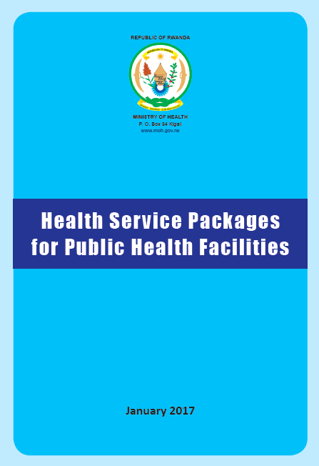
HEALTH SERVICE PACKAGE
Primary Health Care
Annual General checkups and screening
Family planning (Condoms, Pills, Injection)
HIV voluntary counseling & testing (VCT) and Provider Initiated Testing (PIT)
Primary curative consultation
Management of communicable and non-communicable diseases: Eg: influenza, malaria, diarrhea, Clinical IMCI.
Wound care
Postnatal consultation(After 1 week of birth)
Follow up of malnutrition cases
Follow up of treatment initiated at upper level. Eg: DOT for Tuberculosis.
Palliative Care and Pain management
Laboratory/Rapid Test
Glycaemia/Glucosurie Rapid Test
Rapid test for malaria
HIV Testing
Pregnancy test
Pharmacy
Dispensing/Referring to the list of drugs authorized at HP level

Slide 13
Success stories
Reduced travel distance (between 0-3 km) and reduction in transportation costs to and from the usual health center (approximately between 5-15 km)
Reduction in time spent at health facility and the number of productive days lost.
Increased accessibility by large number of population (range of 300-1800 clients per month and per HP).
Community awareness and behaviour change related to (non-) communicable diseases prevention and use of family planning program.
Subscription to the national community based health insurance (CBHI) scheme leading to increased use and affordability of HP provided health services.
Use of HP services reduced over the-counter medications and mitigated the financial risk associated with out-of-pocket expenditures due to the universal health insurance coverage.

Slide 14
Financial Sustainability through Private-Public Partnerships
A Health Post’s building and equipping requires a needed investment of $22,000 USD.
Rwanda’s national target of 1 Health Post per cell (2148), a burden on the Health Sector remains.
The innovative PPP Health Post model intervention offers a sustainable solution.
Investment, staffing, and management costs shared between the community, local leadership, the Ministry of Health and public and private partners can share the fiscal burden for rapid scale-up.
Notes:
With the rapid progress of Rwanda’s socio-economic status towards becoming a mid-income country, the burden of NCDs in the epidemiologic situation of the country that causes the emergence of new needs in terms of health services and requirement for adapted infrastructures and equipment, the reduction of the external financing in Rwanda, Increased mobilization of domestic resources and an increased role of the private sector and civil society will contribute to the mitigation of these effects.

Slide 15
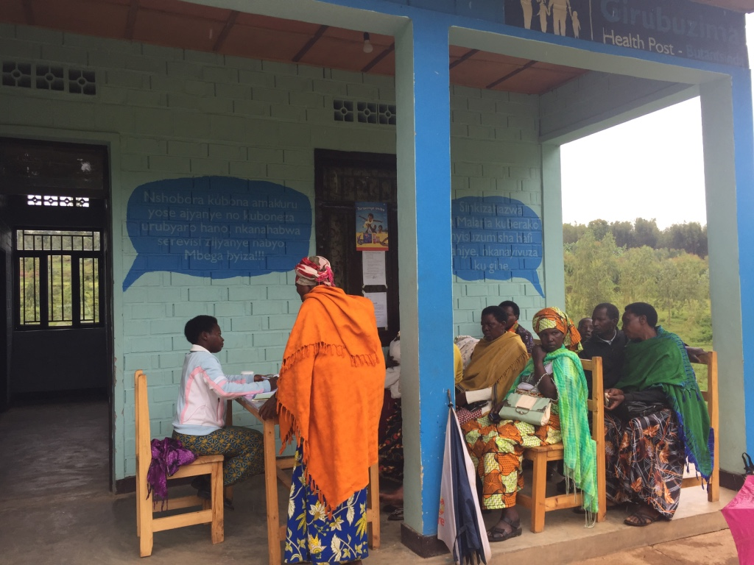
THANK YOU

