Slide 1
Establishing Clinical Trials Registries in Africa: The Tanzanian Perspective
7th East African Health and Scientific Conference
Julius Nyerere International Convention Center,
Dar Es Salaam – Tanzania,
27th -29th March, 2019
Alambo K. Mssusa
Clinical Trials Control and Pharmacovigilance Section
Tanzania Food and Drugs Authority
Authors: Alambo K. Mssusa, Keneth Mvily, Adam. M. Fimbo, Kissa Mwamwitwa, Ambele Mwafula, Akida M. Khea

Slide 2
Background
Registration of clinical trials in public databases is essential in avoiding publication bias, selective reporting and duplications.
WHO recommends CTs to be registered and published in registries with datasets that conform to established standards.
Registration assists in evidence-based decision making, transparency, awareness, recruitment and gap identification.
The International Clinical Trials Registry Platform (ICTRP) does not contain primary registries from African countries that meet the WHO registry criteria.
The African Vaccine Regulatory Forum (AVAREF) member states agreed that National registries should be developed to harmonize regulatory control of clinical trials conducted in Africa.
In line with this initiative, legal requirements were established in the Tanzania Clinical Trials Control Regulations (2013) requiring registration of the trials in the National Registry.

Slide 3
Objective
To establish a clinical trials registry that is publicly accessible and meets WHO minimum standards
Methods
A web based clinical trials registry was created basing on the WHO trial registration data set version 1.2.1
The registry was developed considering the WHO ICTRP registry criteria

Slide 4
Results and Discussion
A registry named “The Tanzania Clinical Trials Registry (TzCTR)” was created
Hosted by TFDA
Publicly accessed at: www.tzctr.or.tz or www.tfda.go.tz
Has core components that included data validity verification, in-built security, audit trail and administration platform
A total of 20 data sets in line with the WHO requirements were developed.

Slide 5
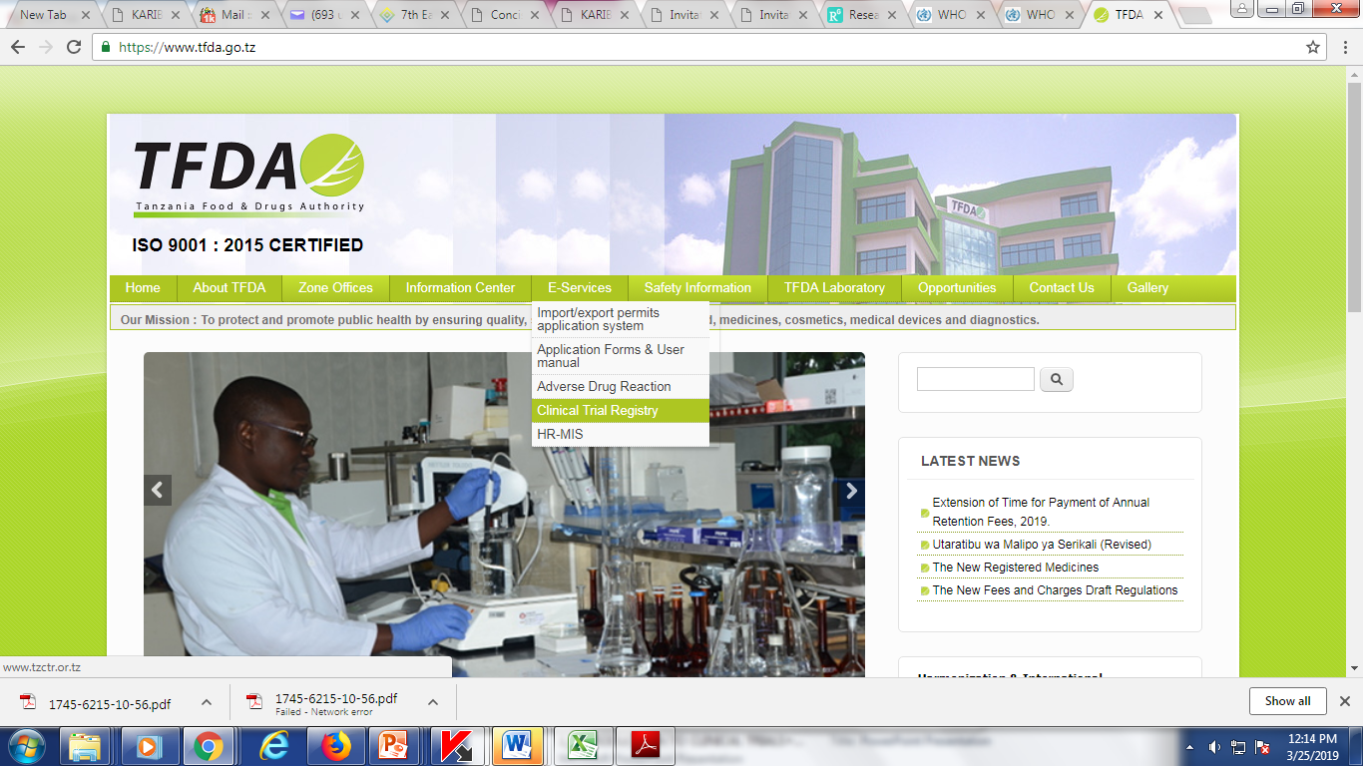
Accessibility

Slide 6
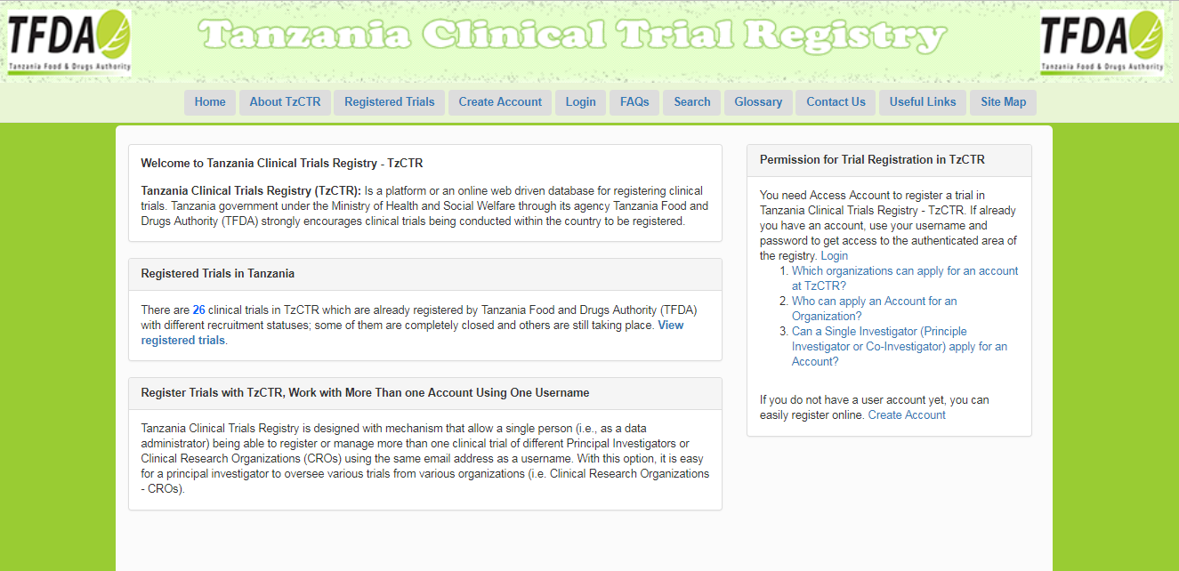
Tanzania Clinical Trial Registry (TzCTR).

Slide 7
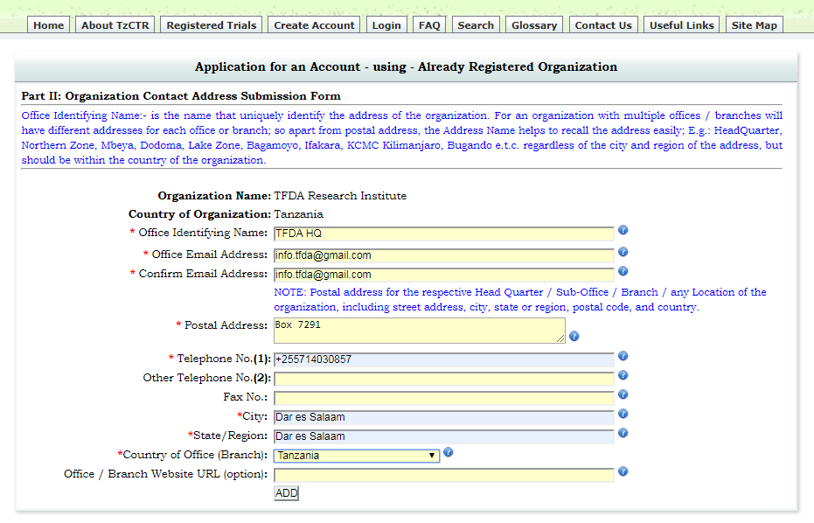
Account Creation
Organization/CRO
Principal Investigator
Co-Investigator
Data Administrator, OR
Any authorized person
Verify
Organization Existence
Submit Organization
&
Contact Details
Submit
Applicant Details
Create an Account
Create Login Access
If Yes, Select from the list

Slide 8
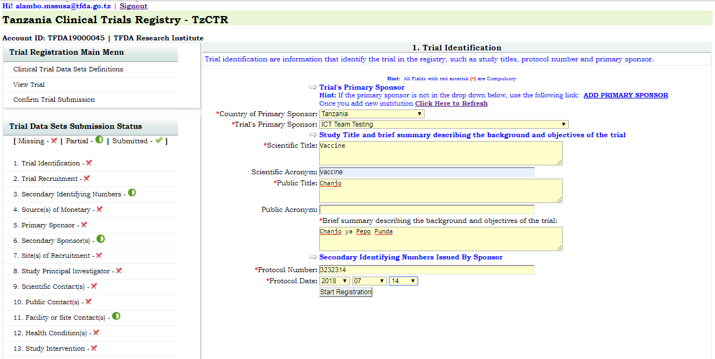
Registration of a new Application

Slide 9
Preview of Data

Slide 10
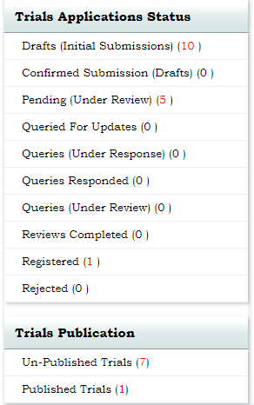
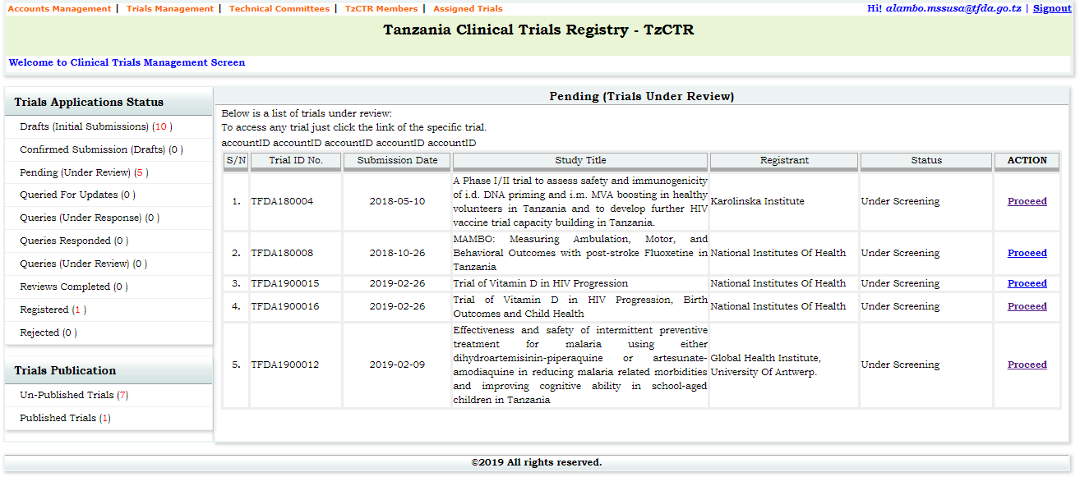
TFDA Review of Applications
Review
&
Verify
Query
Reject
Approve
Register &
Publish
Receive

Slide 11
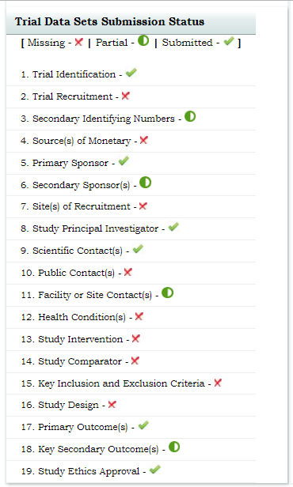

Slide 12
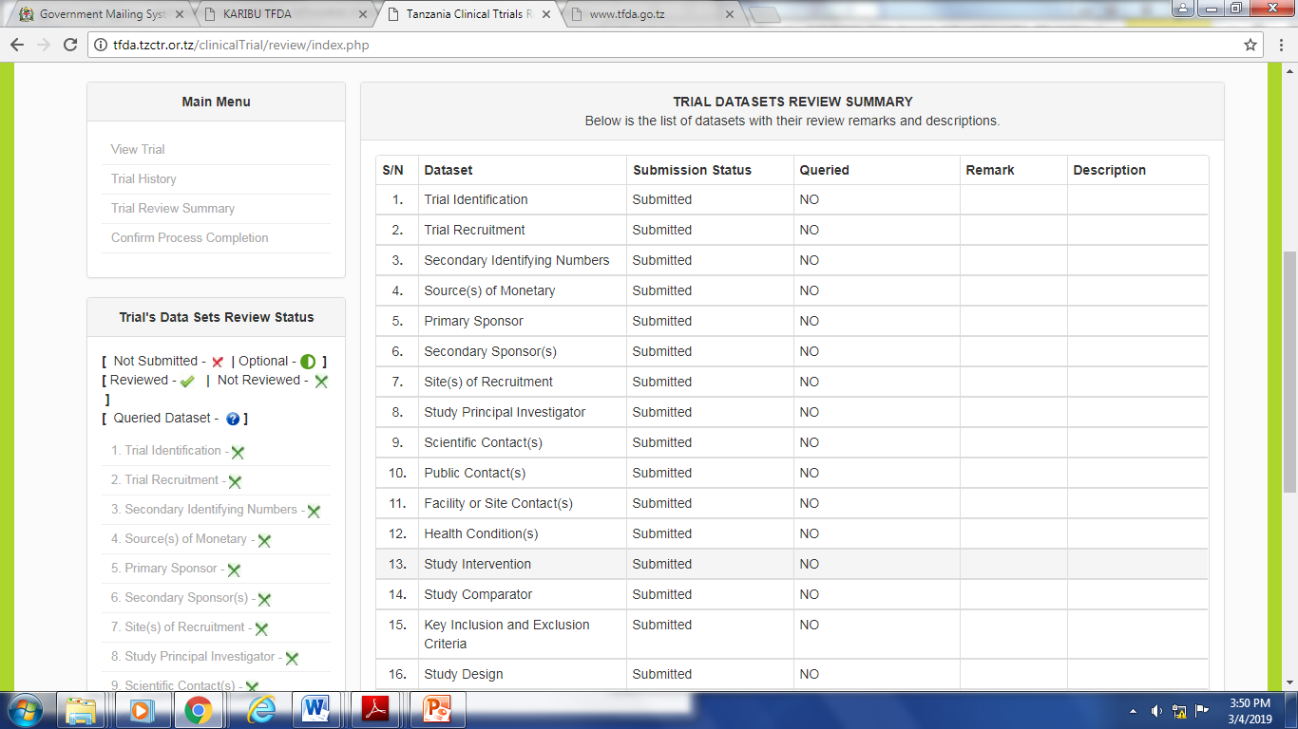
Preview and Registration
Registered CT

Slide 13
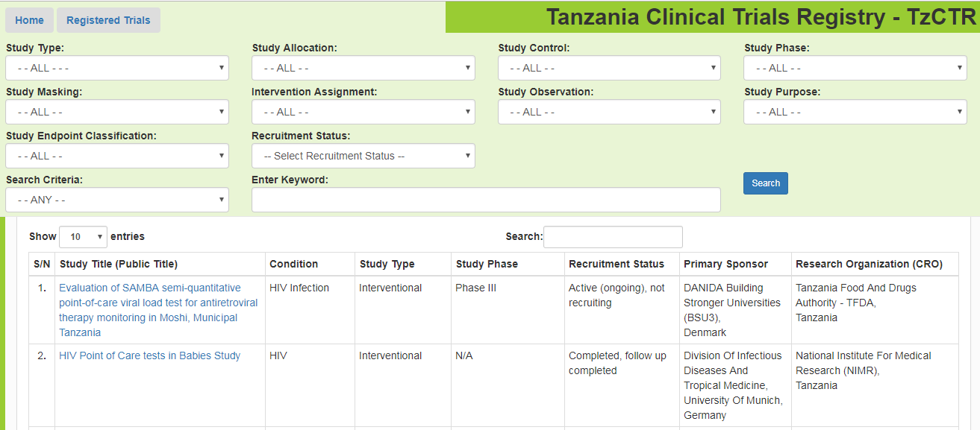
Public Search Features

Slide 14
Conclusion
The system is consistent with the international clinical trials registry standards
The system efficiency requires collaboration between the Research Institutions and the Regulatory Authority
Adequate staff, funding, security and commitment are required to ensure data integrity
The Registry is a platform for harmonization of regulatory procedures on clinical trials control

Slide 15
Acknowledgments
Colleagues:
Keneth Mvily,
Adam. M. Fimbo,
Kissa Mwamwitwa,
Ambele Mwafula,
Akida M. Khea
Management support: TFDA leadership
TFDA- Clinical Trials Technical Committee
TFDA staff
Clinical trial Investigators & Stakeholders who provided feedback to the system

